Slide 1
Constraint Satisfaction Problem
Local Search for CSP, Min-Conflicts Heuristics, and Constraint Weighting.

Slide 2
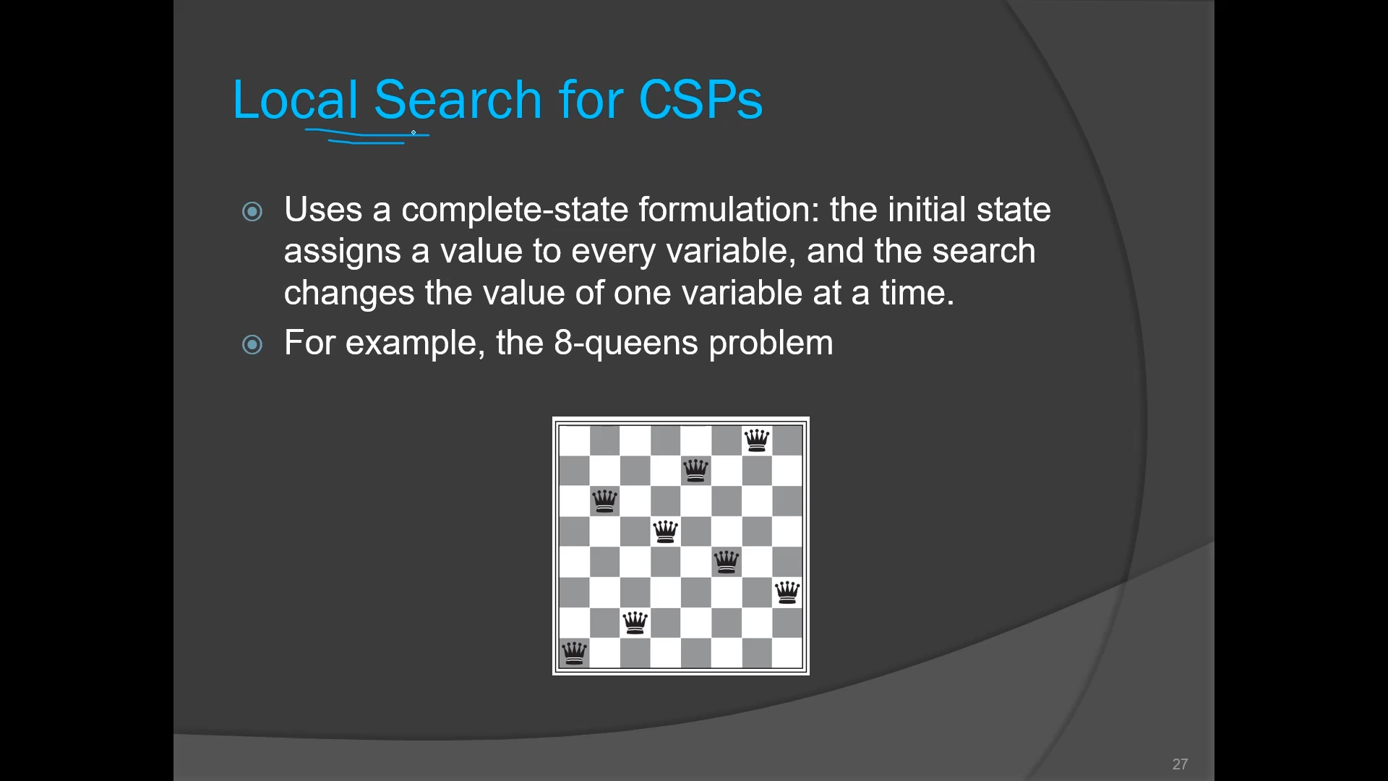
Local Search

Slide 3
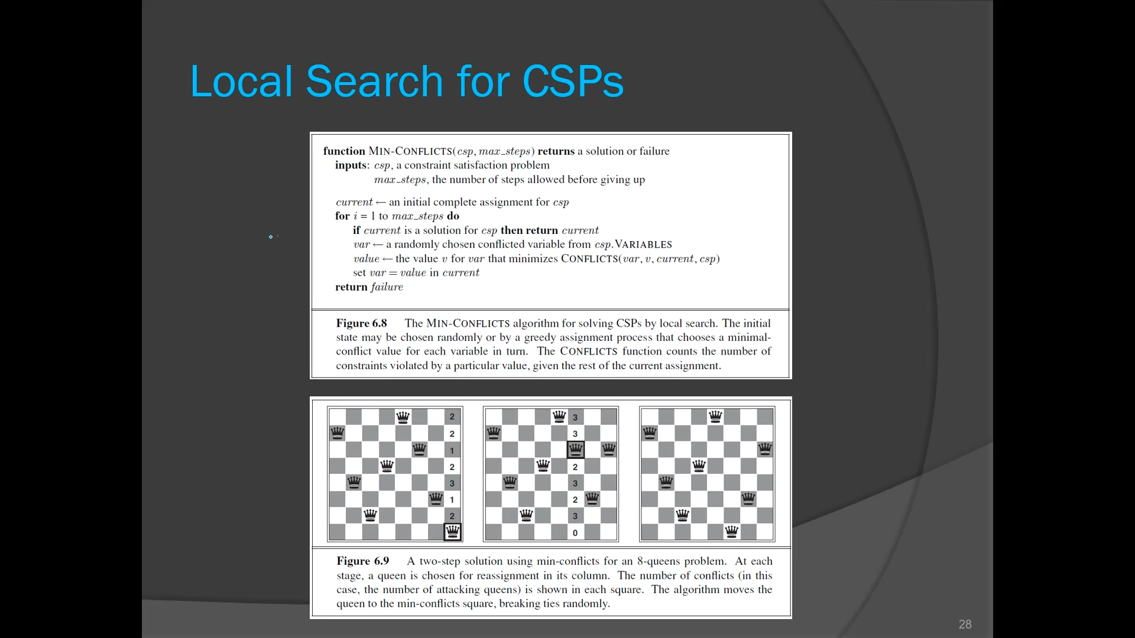
Local Search

Slide 4
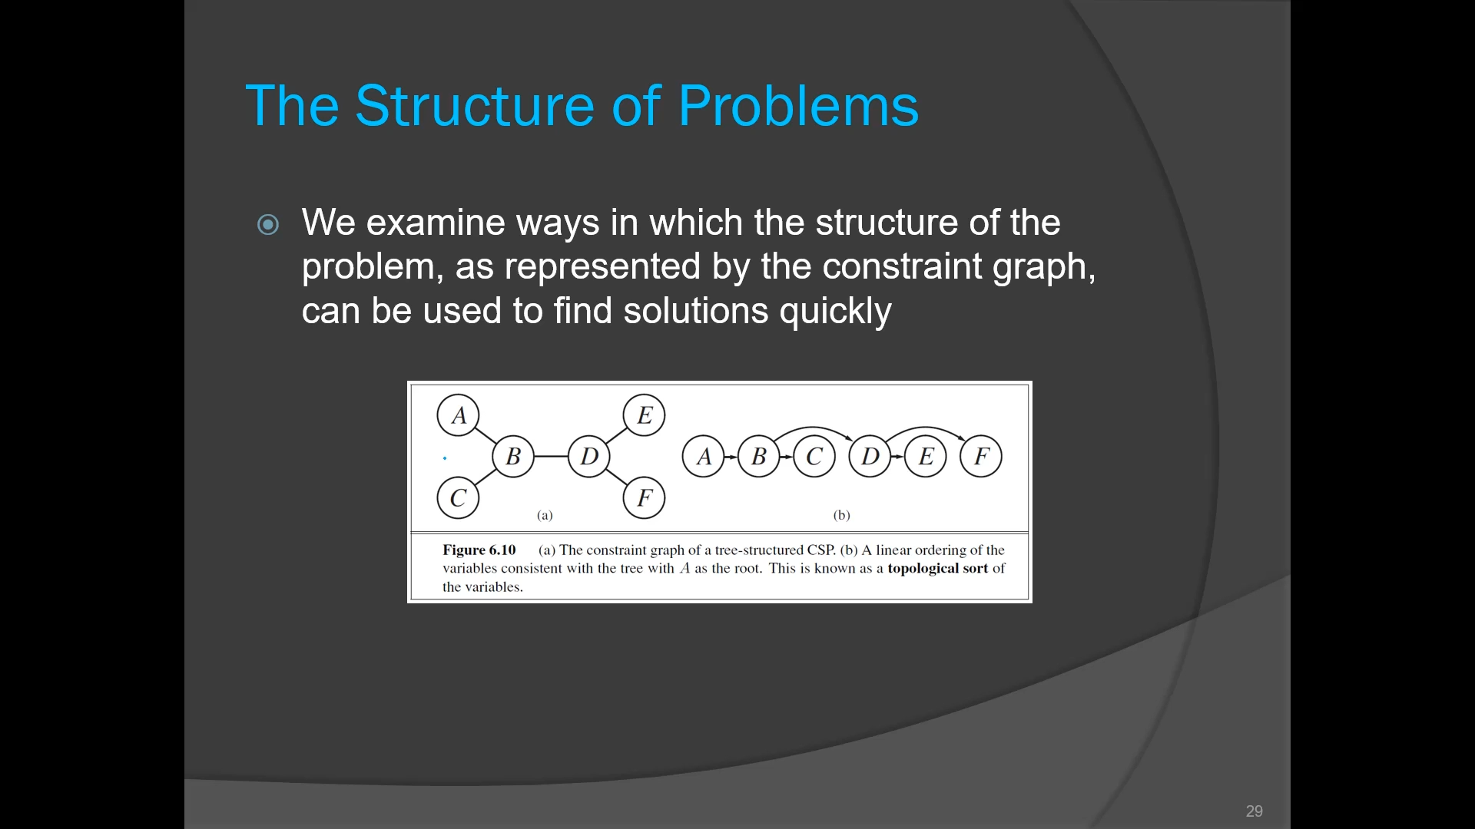
The Structure of a Problem

Slide 5
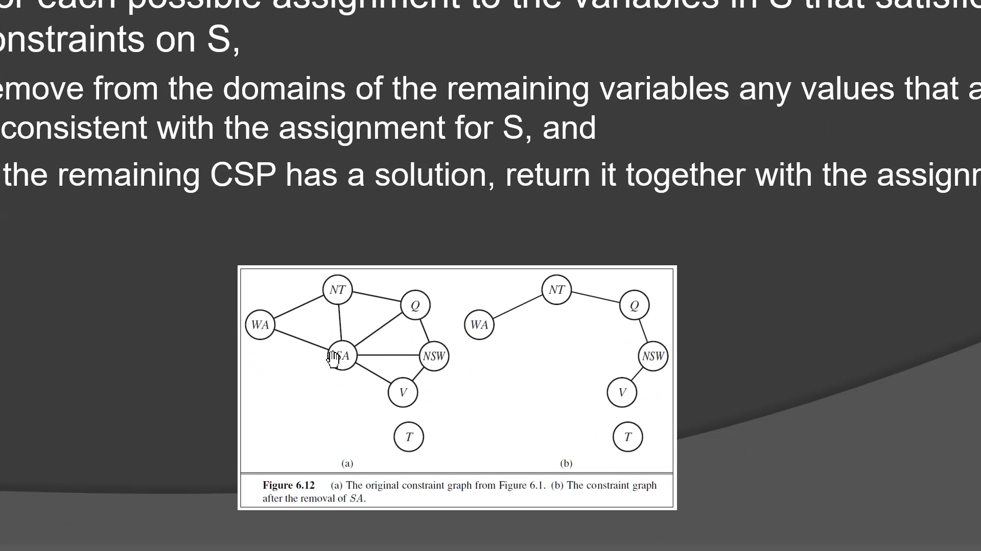
The Structure of a Problem

Slide 6
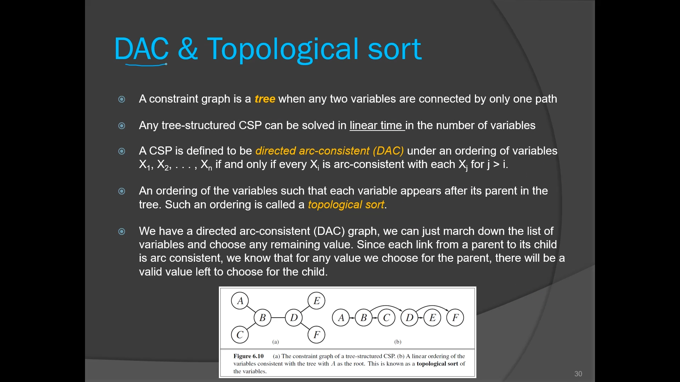
DAC and Topological Sort

Slide 7
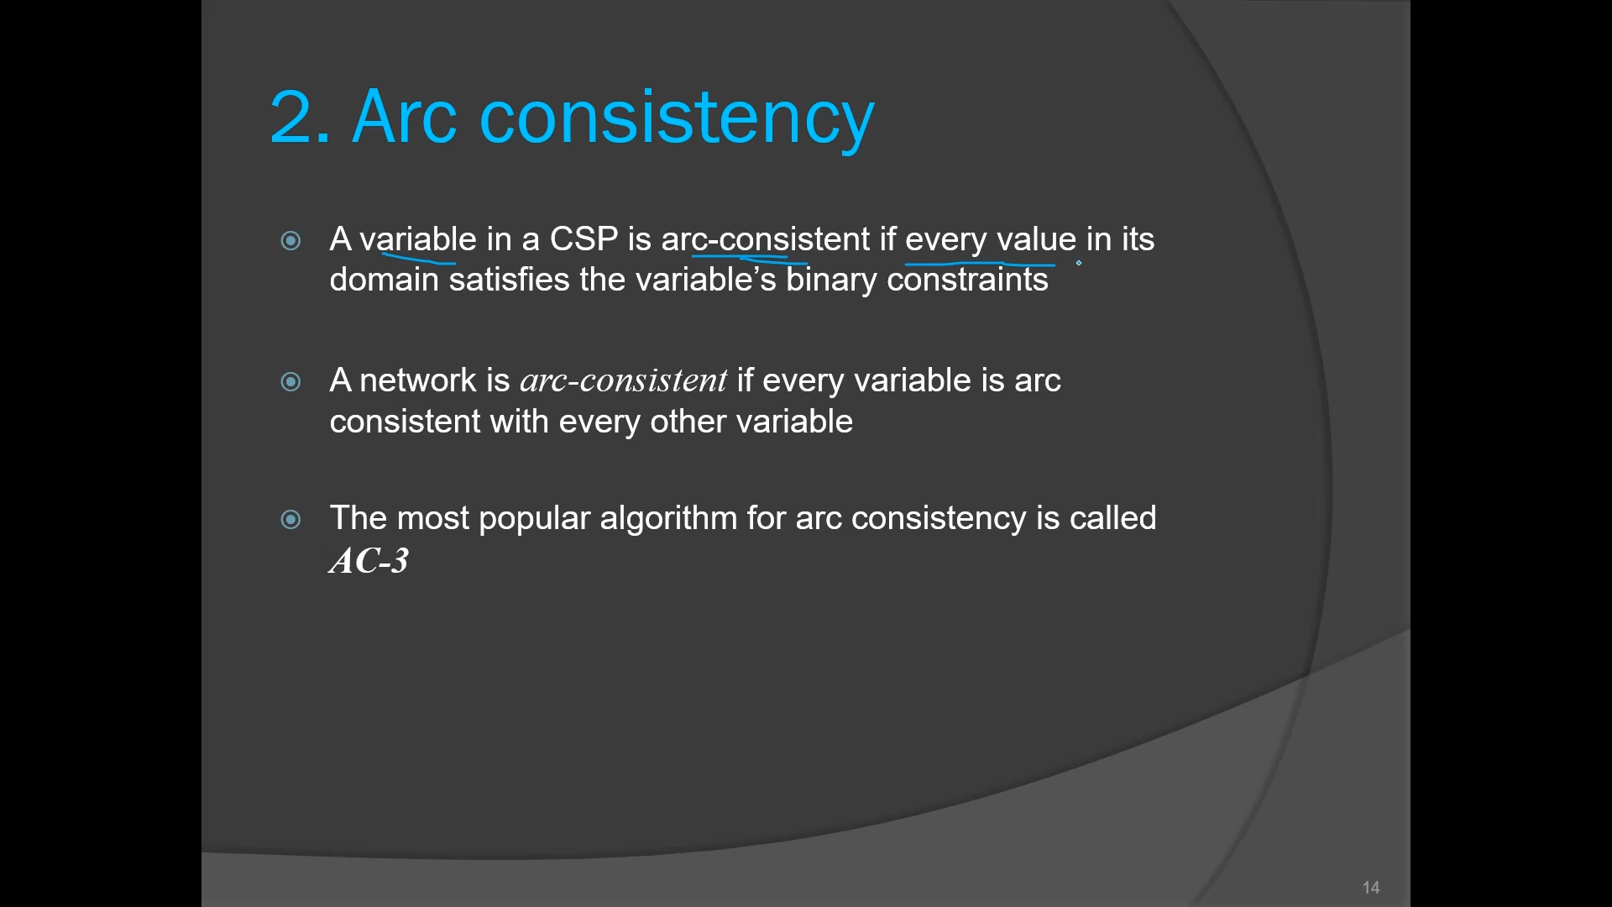
DAC and Topological Sort

Slide 8
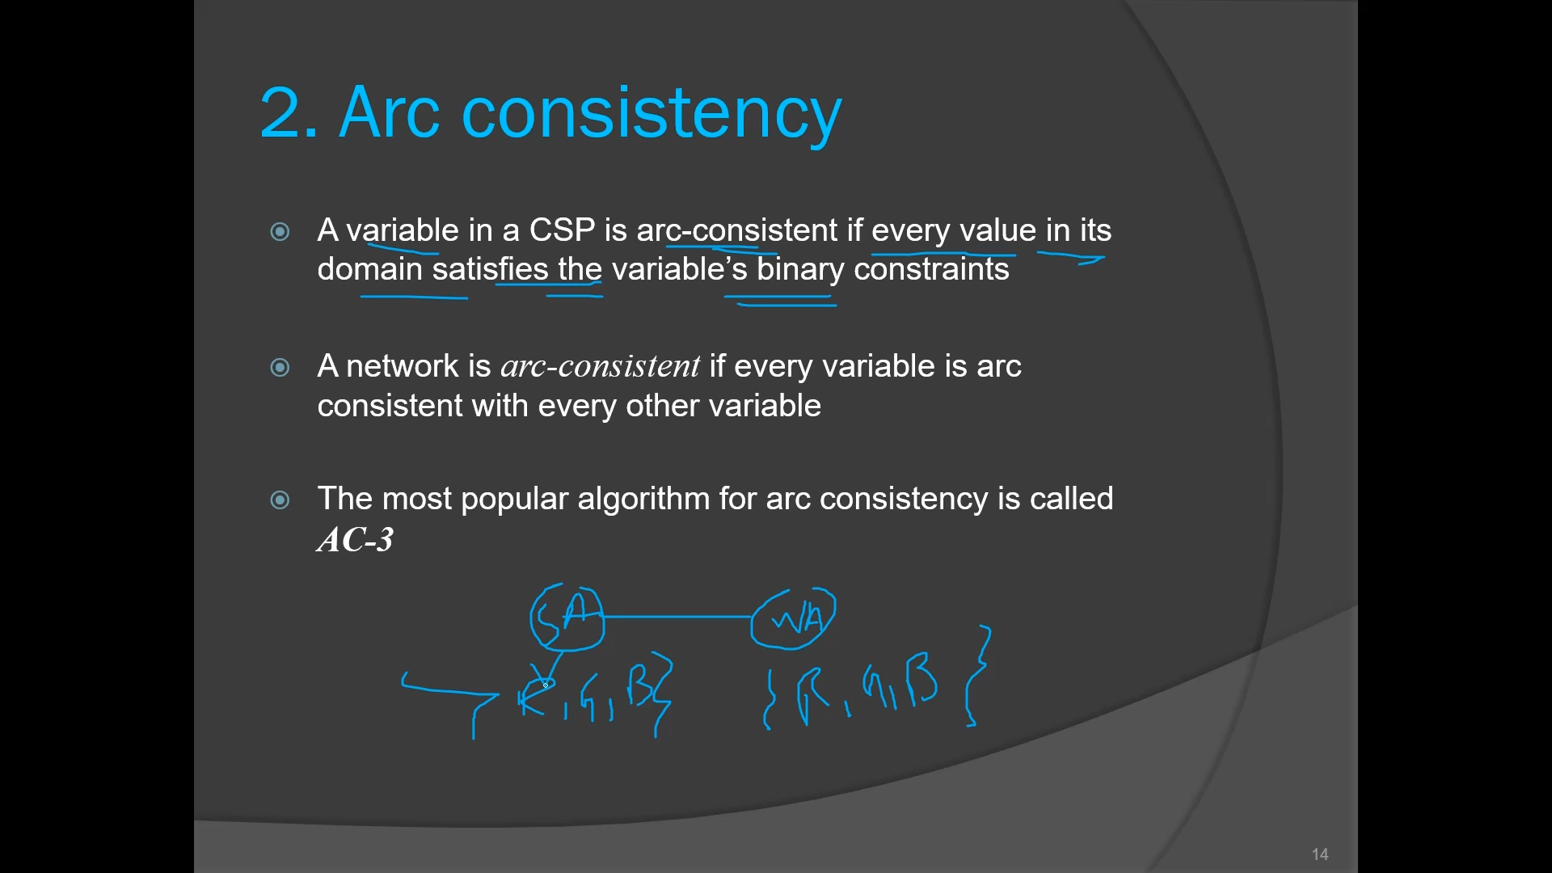
DAC and Topological Sort

Slide 9
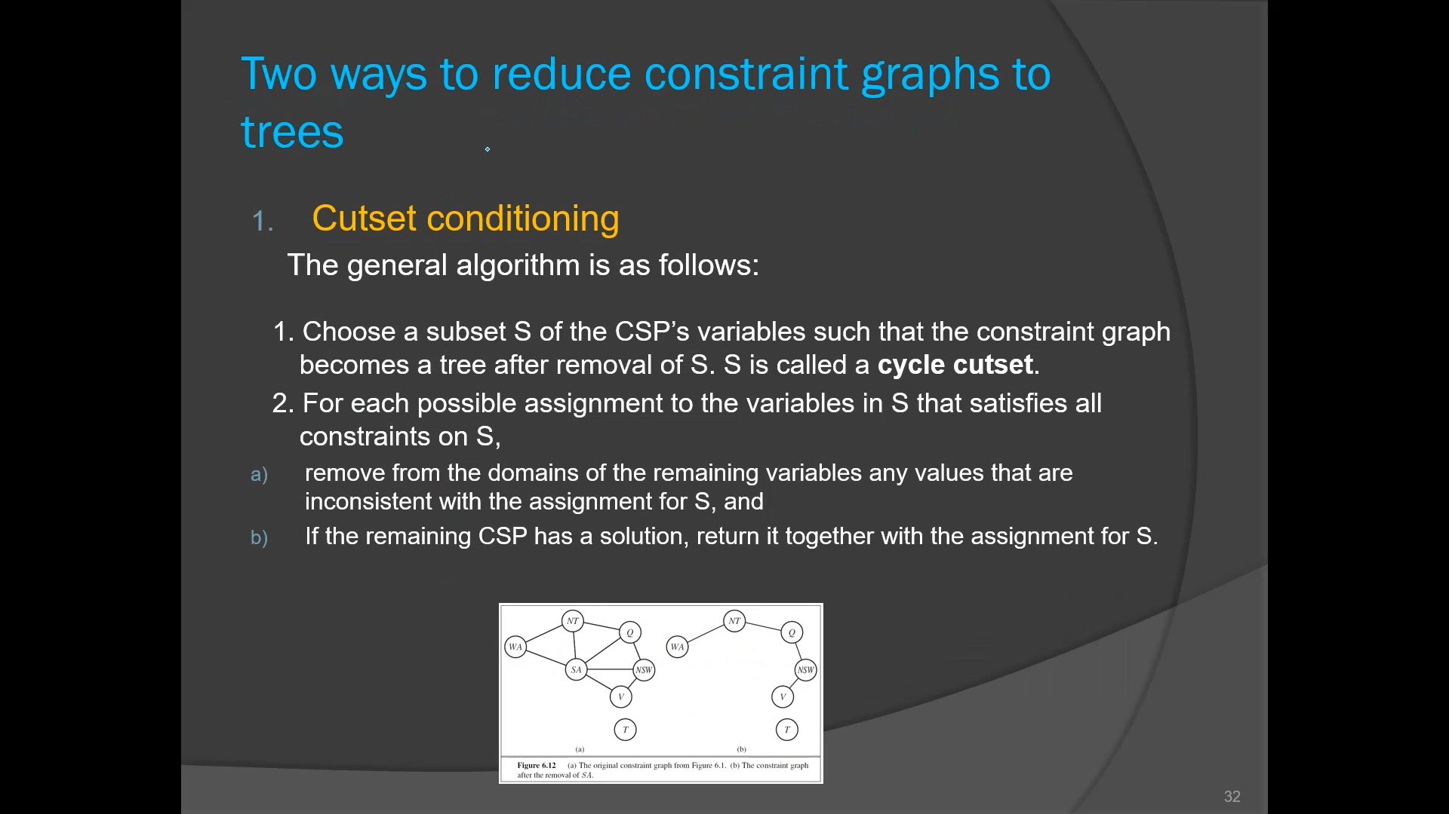
Ways to Reduce constraint graphs to trees

Slide 10
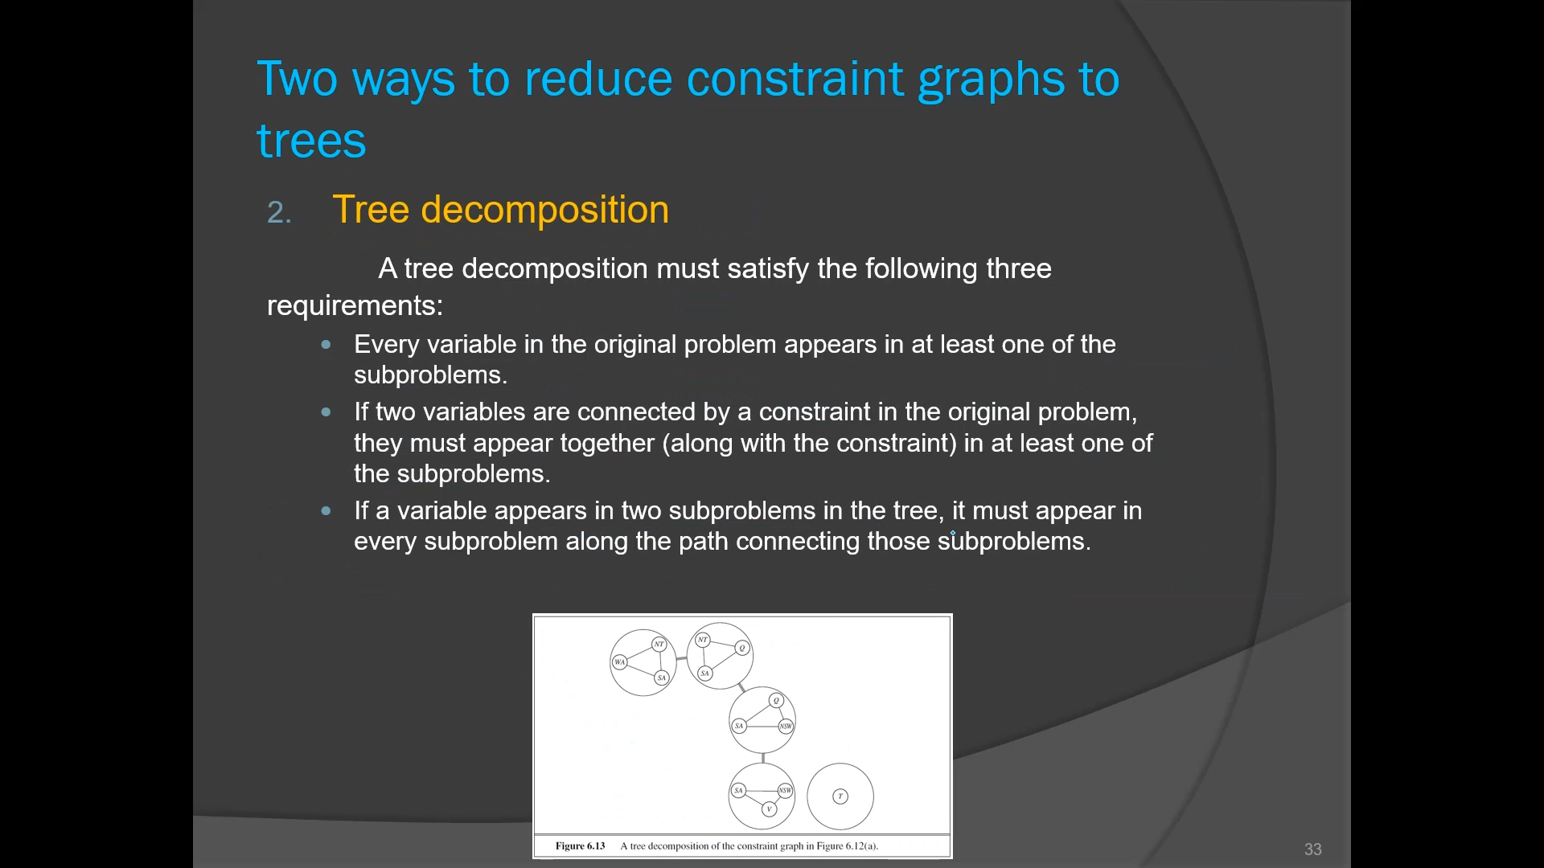
Ways to Reduce Constraint Graphs to Trees

